Slide 1
Software Engineering
Lecture 4

Slide 2

What is a Class Diagram?
A Class Diagram is a type of UML (Unified Modeling Language) diagram that shows the structure of a system by representing:
Classes
Attributes (variables)
Methods (functions)
Relationships between classes
It is used in object-oriented programming (OOP) to design software before coding.

Slide 3
Main Parts of a Class Diagram
Each class is drawn as a rectangle with 3 sections:
+------------------+
| Class Name |
+------------------+
| Attributes |
+------------------+
| Methods |
+------------------+

Slide 4
1.Class Name
The name of the class
2. Attributes
Variables that store data
3. Methods
Functions the class can perform

Slide 5
TarifSchedule
Enumeration getZones()
Price getPrice(Zone)
Trip
*
*
zone:Zone
Price: Price
Class diagrams represent the structure of the system.
Used
during requirements analysis to model problem domain concepts
during system design to model subsystems and interfaces
during object design to model classes.

Slide 6
Actor vs Instances
What is the difference between an actor , a class and an instance?
Actor:
An entity outside the system to be modeled, interacting with the system (“Passenger”)
Class:
An abstraction modeling an entity in the problem domain, must be modeled inside the system (“User”)
Object:
A specific instance of a class (“Joe, the passenger who is purchasing a ticket from the ticket distributor”).

Slide 7
Classes
TarifSchedule
Table zone2price
Enumeration getZones()
Price getPrice(Zone)
Name
TarifSchedule
Attributes
Signature
zone2price
getZones()
getPrice()
Operations
TarifSchedule
A class represent a concept
A class encapsulates state (attributes) and behavior (operations).
Each attribute has a type.
Each operation has a signature.
The class name is the only mandatory information.

Slide 8
Why Class Diagram is Important
Helps plan software structure
Makes coding easier
Shows relationships clearly
Used in software engineering design and OOP

Slide 9
Associations
TarifSchedule
TripLeg
Enumeration getZones()
Price getPrice(Zone)
*
Price Zone
*
Associations denote relationships between classes.
The multiplicity of an association end denotes how many objects the source object can legitimately reference.

Slide 10
1-to-1 and 1-to-many Associations
Country
Has-capital
City
*
name:String
name:String
One-to-one association
Point
Polygon
*
x: Integer
draw()
y: Integer
One-to-many association

Slide 11
From Problem Statement To Object Model
Pr
oblem Statement: A stock exchange lists many companies. Each
company is uniquely identified by a ticker symbol
Class Diagram:
StockExchange
*
*
Company
Lists
tickerSymbol

Slide 12
Aggregation
An aggregation is a special case of association denoting a “consists of” hierarchy.
The aggregate is the parent class, the components are the children class.
Exhaust system
Exhaust system
1
0..2
1
0..2
Muffler
Tailpipe
Muffler
Tailpipe
diameter
diameter
diameter
diameter

Slide 13
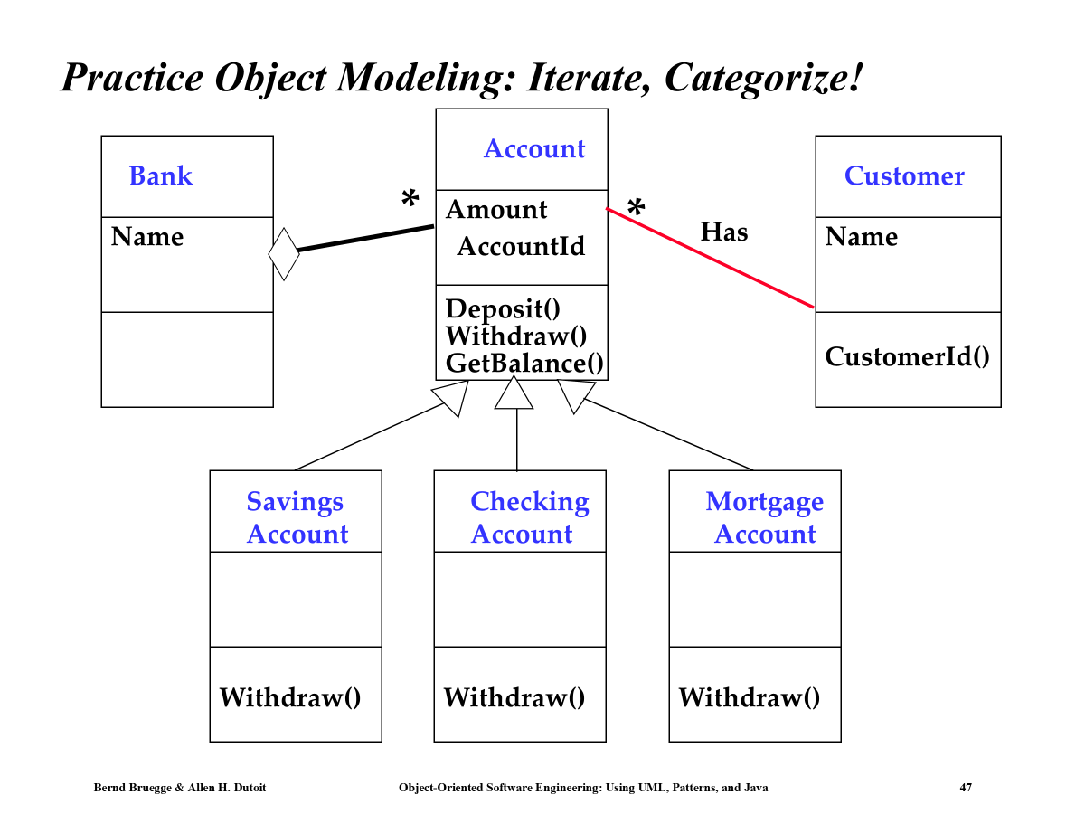

Slide 14
UML sequence diagrams
Used during requirements analysis
To refine use case descriptions
to find additional objects (“participating objects”)
Used during system design
to refine subsystem interfaces
Classes are represented by columns
Messages are represented by arrows
Activations are represented by narrow rectangles
Lifelines are represented by dashed lines
Passenger
TicketMachine
selectZone()
insertCoins()
pickupChange()
pickUpTicket()

Slide 15
Nested messages
Passenger
ZoneButton
TarifSchedule
Display
selectZone()
lookupPrice(selection)
price
Dataflow
displayPrice(price)
…to be continued...
The source of an arrow indicates the activation which sent the message
An activation is as long as all nested activations
Horizontal dashed arrows indicate data flow
Vertical dashed lines indicate lifelines

Slide 16
Iteration & condition
…continued from previous slide...
Passenger
ChangeProcessor
CoinIdentifier
Display
CoinDrop
*
insertChange(coin)
lookupCoin(coin)
Iteration
price
displayPrice(owedAmount)
Condition
[owedAmount<0] returnChange(-owedAmount)
…to be continued...
Iteration is denoted by a * preceding the message name
Condition is denoted by boolean expression in [ ] before the message name

Slide 17
Creation and destruction
…continued from previous slide...
Passenger
ChangeProcessor
Creation
createTicket(selection)
Ticket
print()
free()
Destruction
Creation is denoted by a message arrow pointing to the object.
Destruction is denoted by an X mark at the end of the destruction activation.
In garbage collection environments, destruction can be used to denote the end of the useful life of an object.

Slide 18
State Chart Diagrams
Initial state
State
Event
Transition
Final state
Represent behavior as states and transitions

